Slide 1

Algorithms and Data Structures 2 CS 1501
Fall 2021
Sherif Khattab
ksm73@pitt.edu
(Slides are adapted from Dr. Ramirez’s and Dr. Farnan’s CS1501 slides.)

Slide 2
Announcements
Upcoming deadlines:
4/21: Assignment 4
4/21: Homework 12
4/23: Lab 11
4/30: Lab 12
5/2: Assignment 5
5/2: Bonus Homework
Extra Lecture Videos on dynamic programming and approximation algorithms
Tophat questions are due one week after each lecture
OMETs
1 bonus point for entire class when response rate >= 80%
Currently at ~48%
Deadline is Sunday 4/25

Slide 3
Last lecture …
(Big)Integer Algorithms
RSA encryption

Slide 4
Muddiest points
RSA Example
Phi(n)
Reduction and RSA attacks

Slide 5
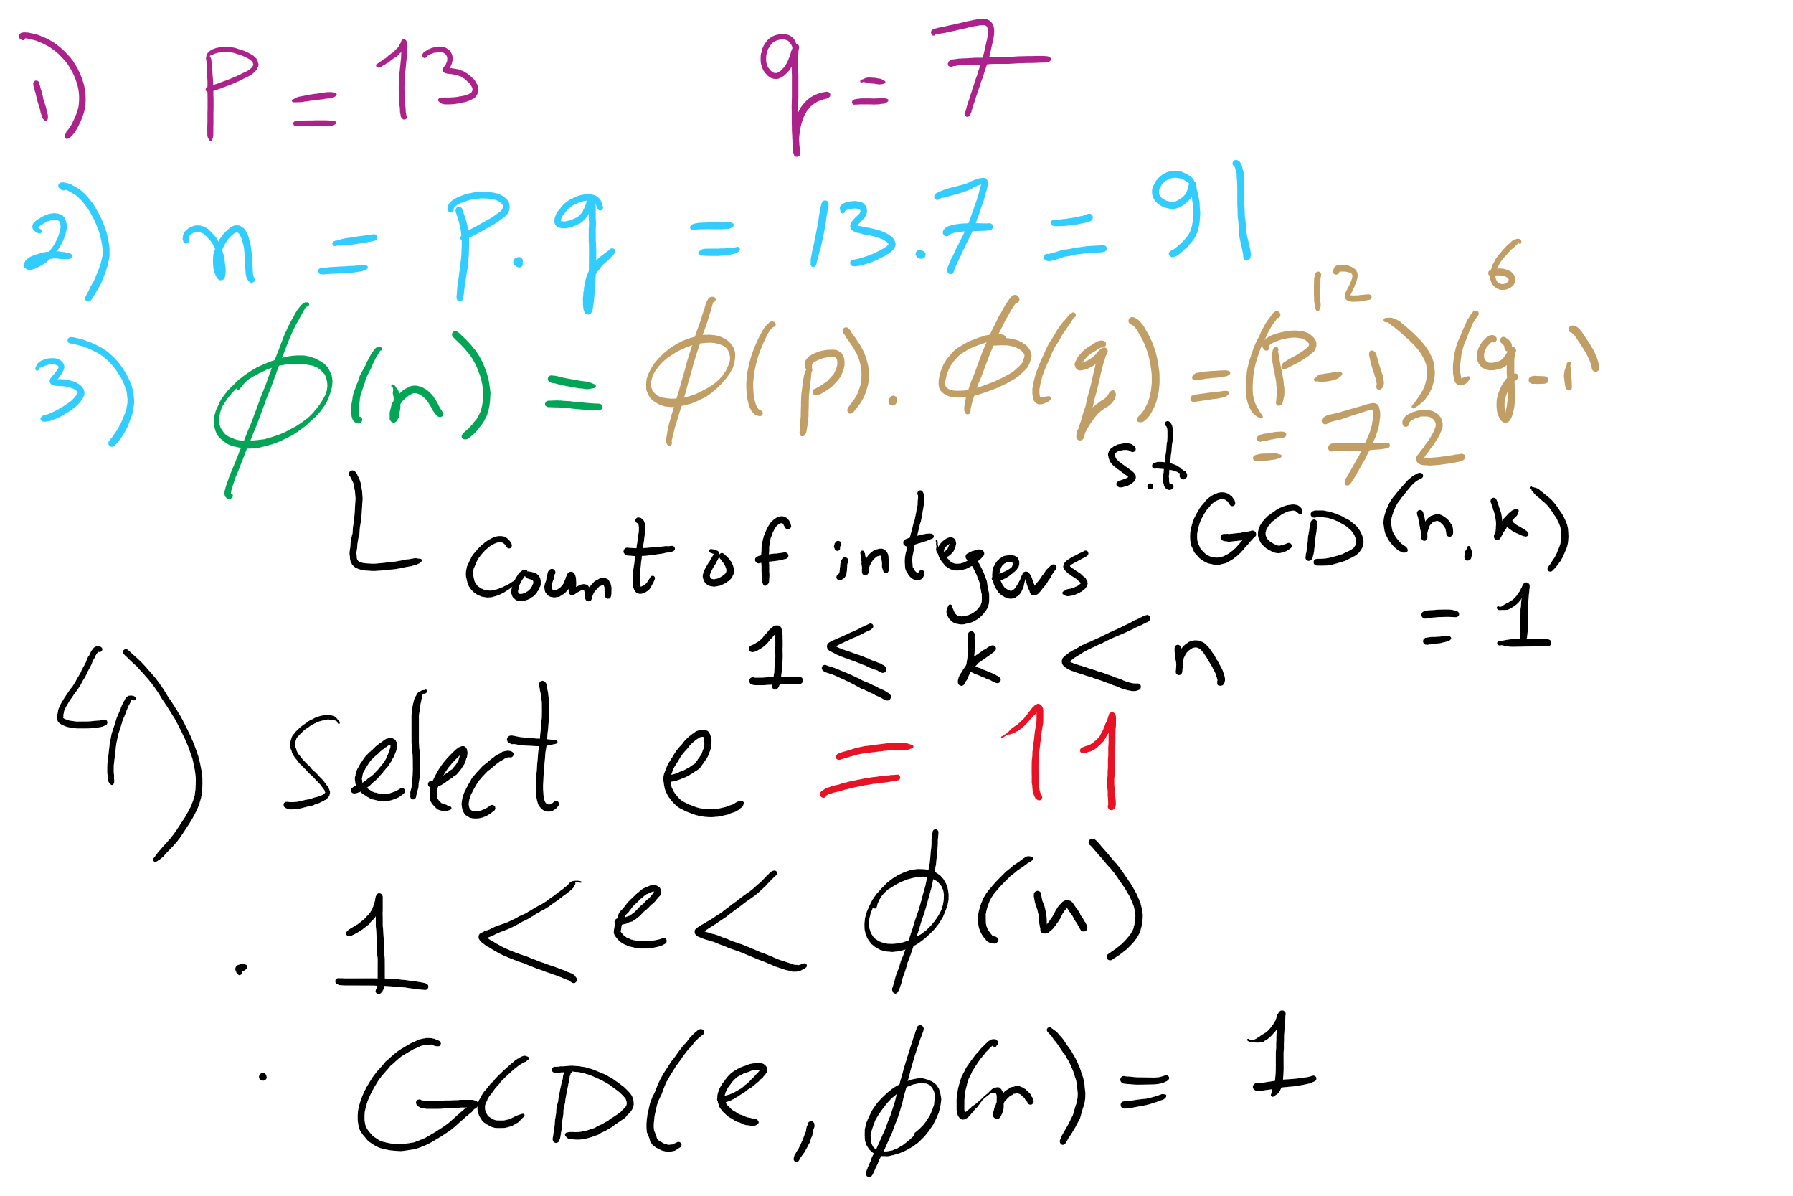
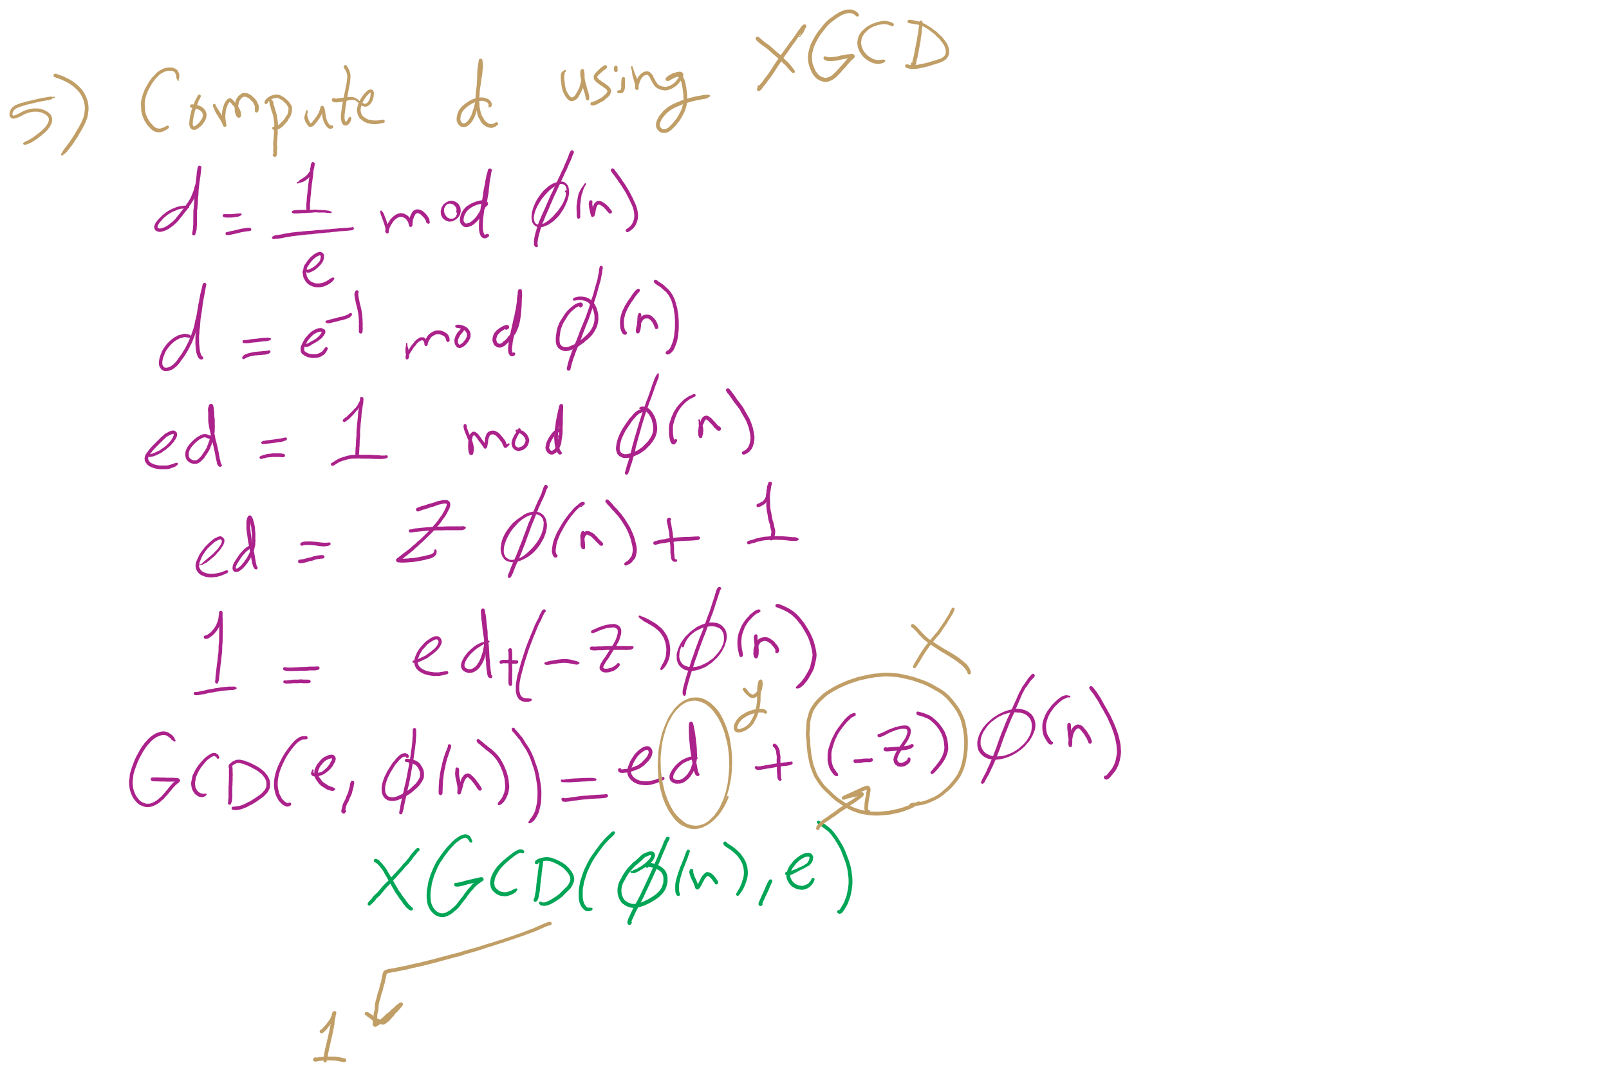
RSA Example 1

Slide 6
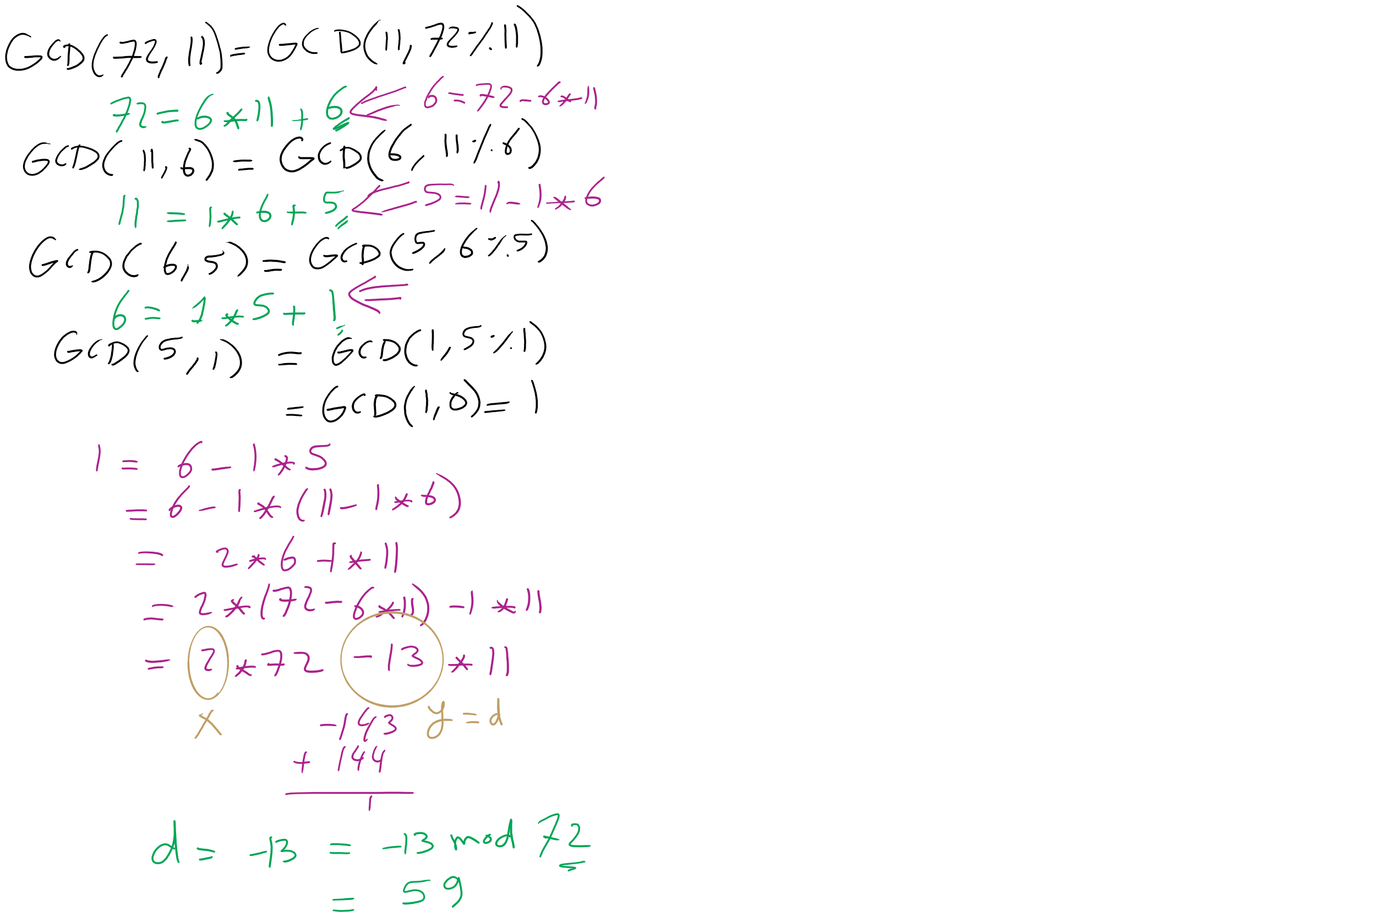
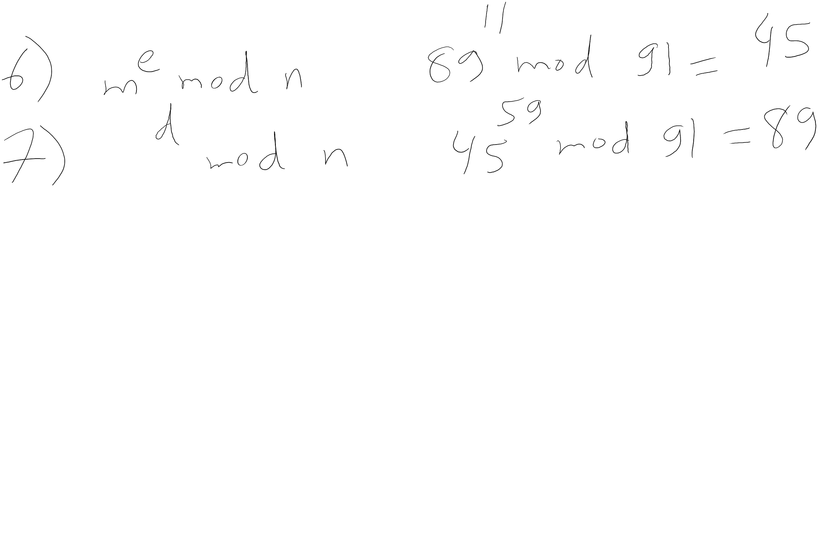
RSA Example 1 (contd.)

Slide 7
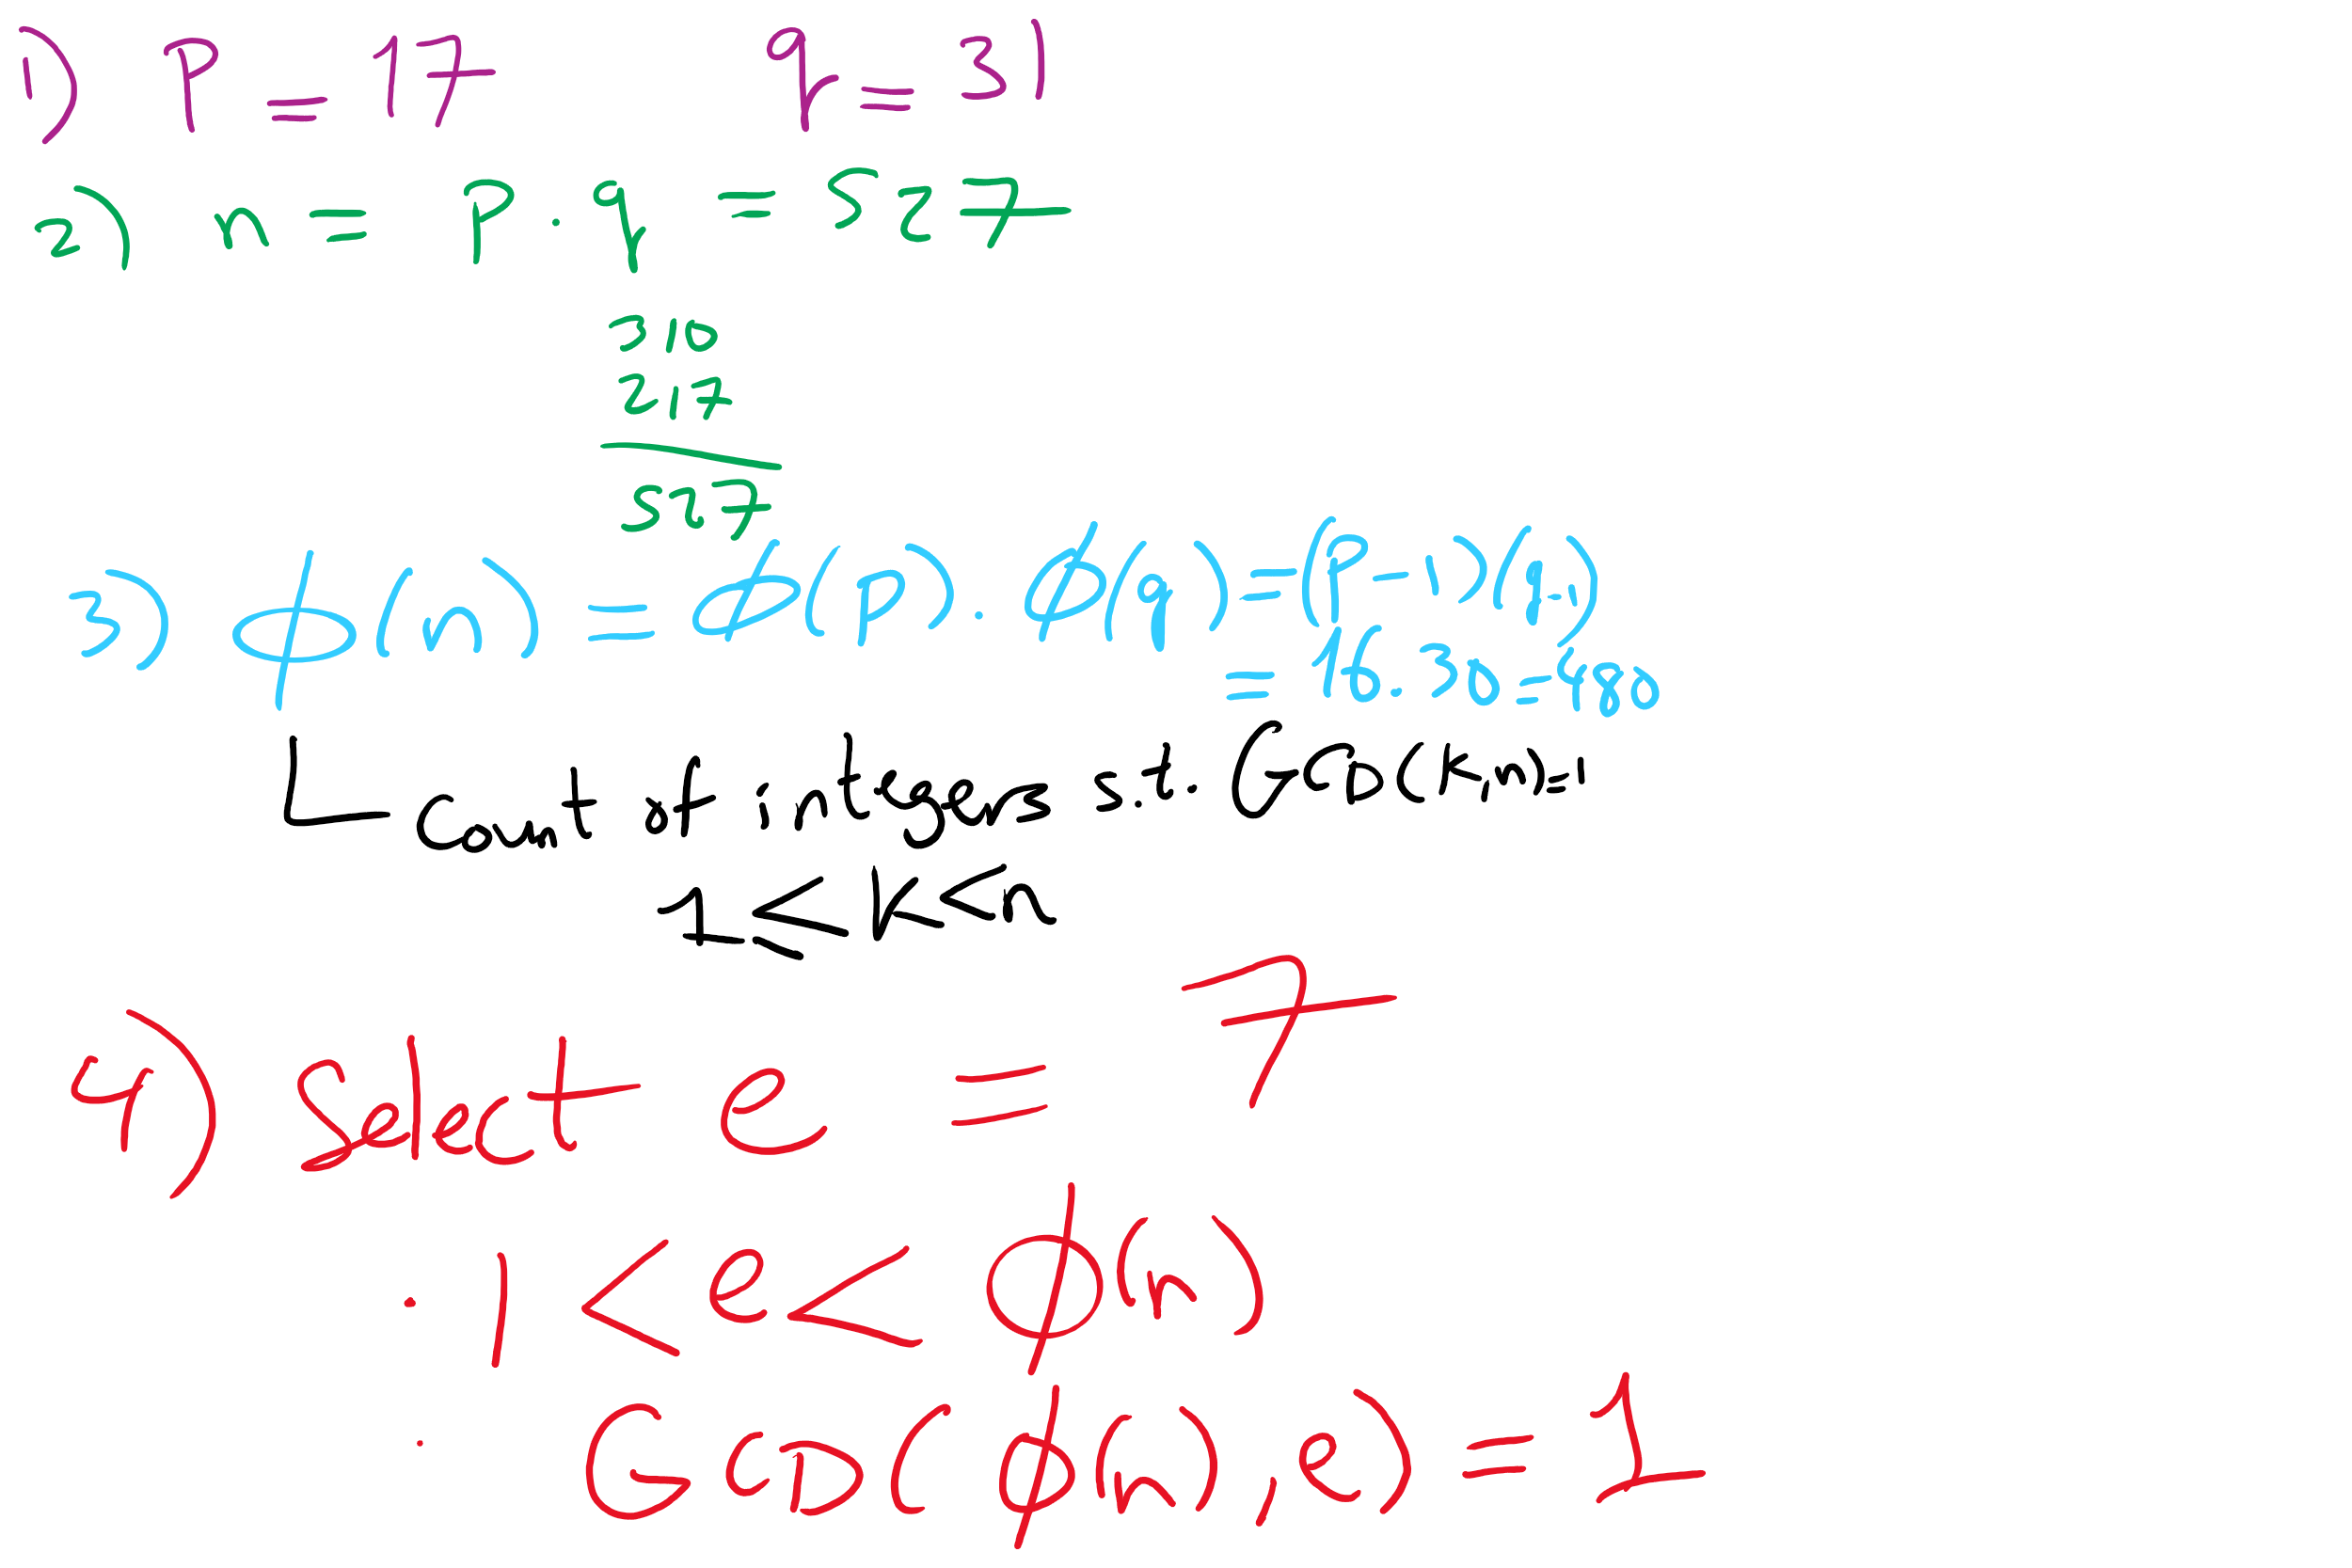
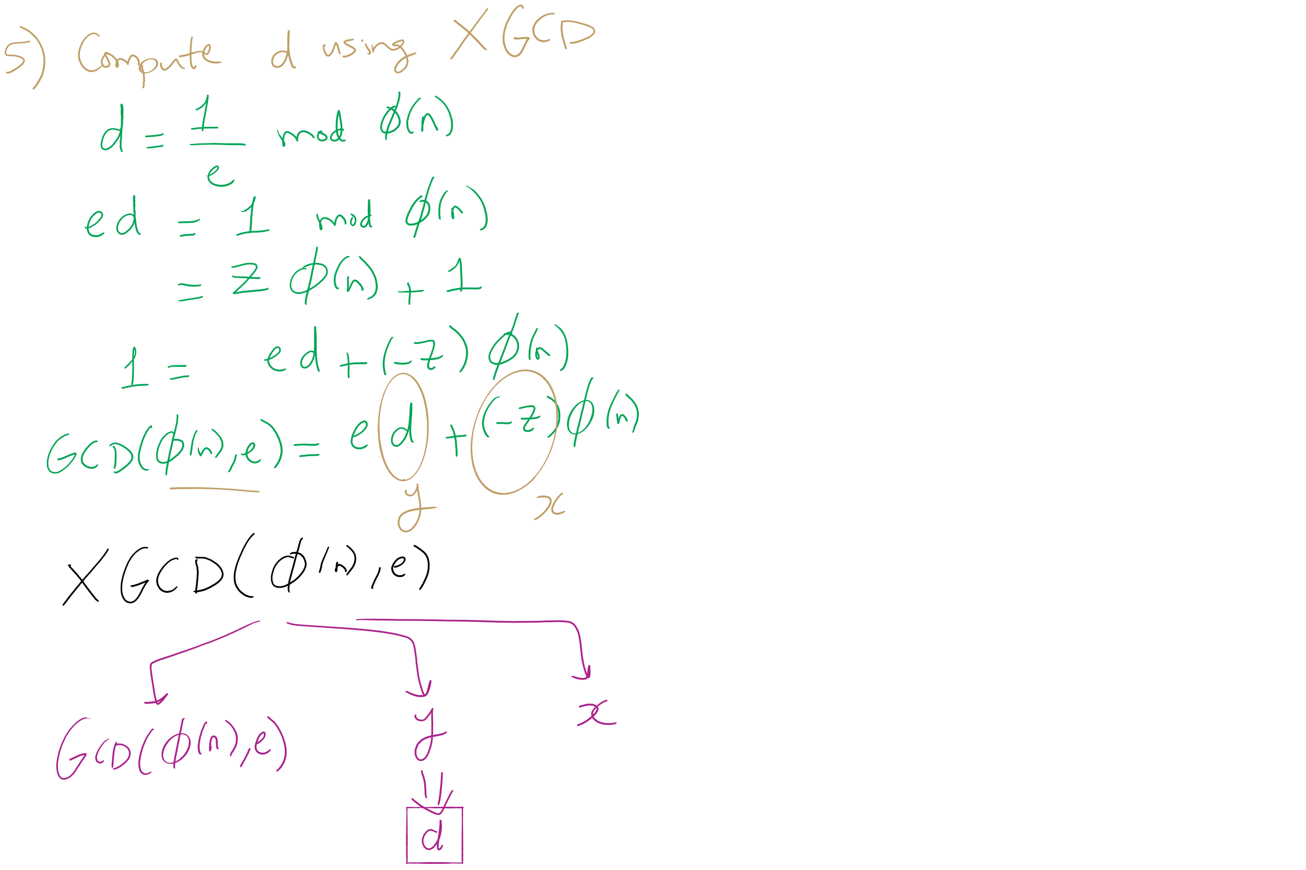
RSA Example 2

Slide 8
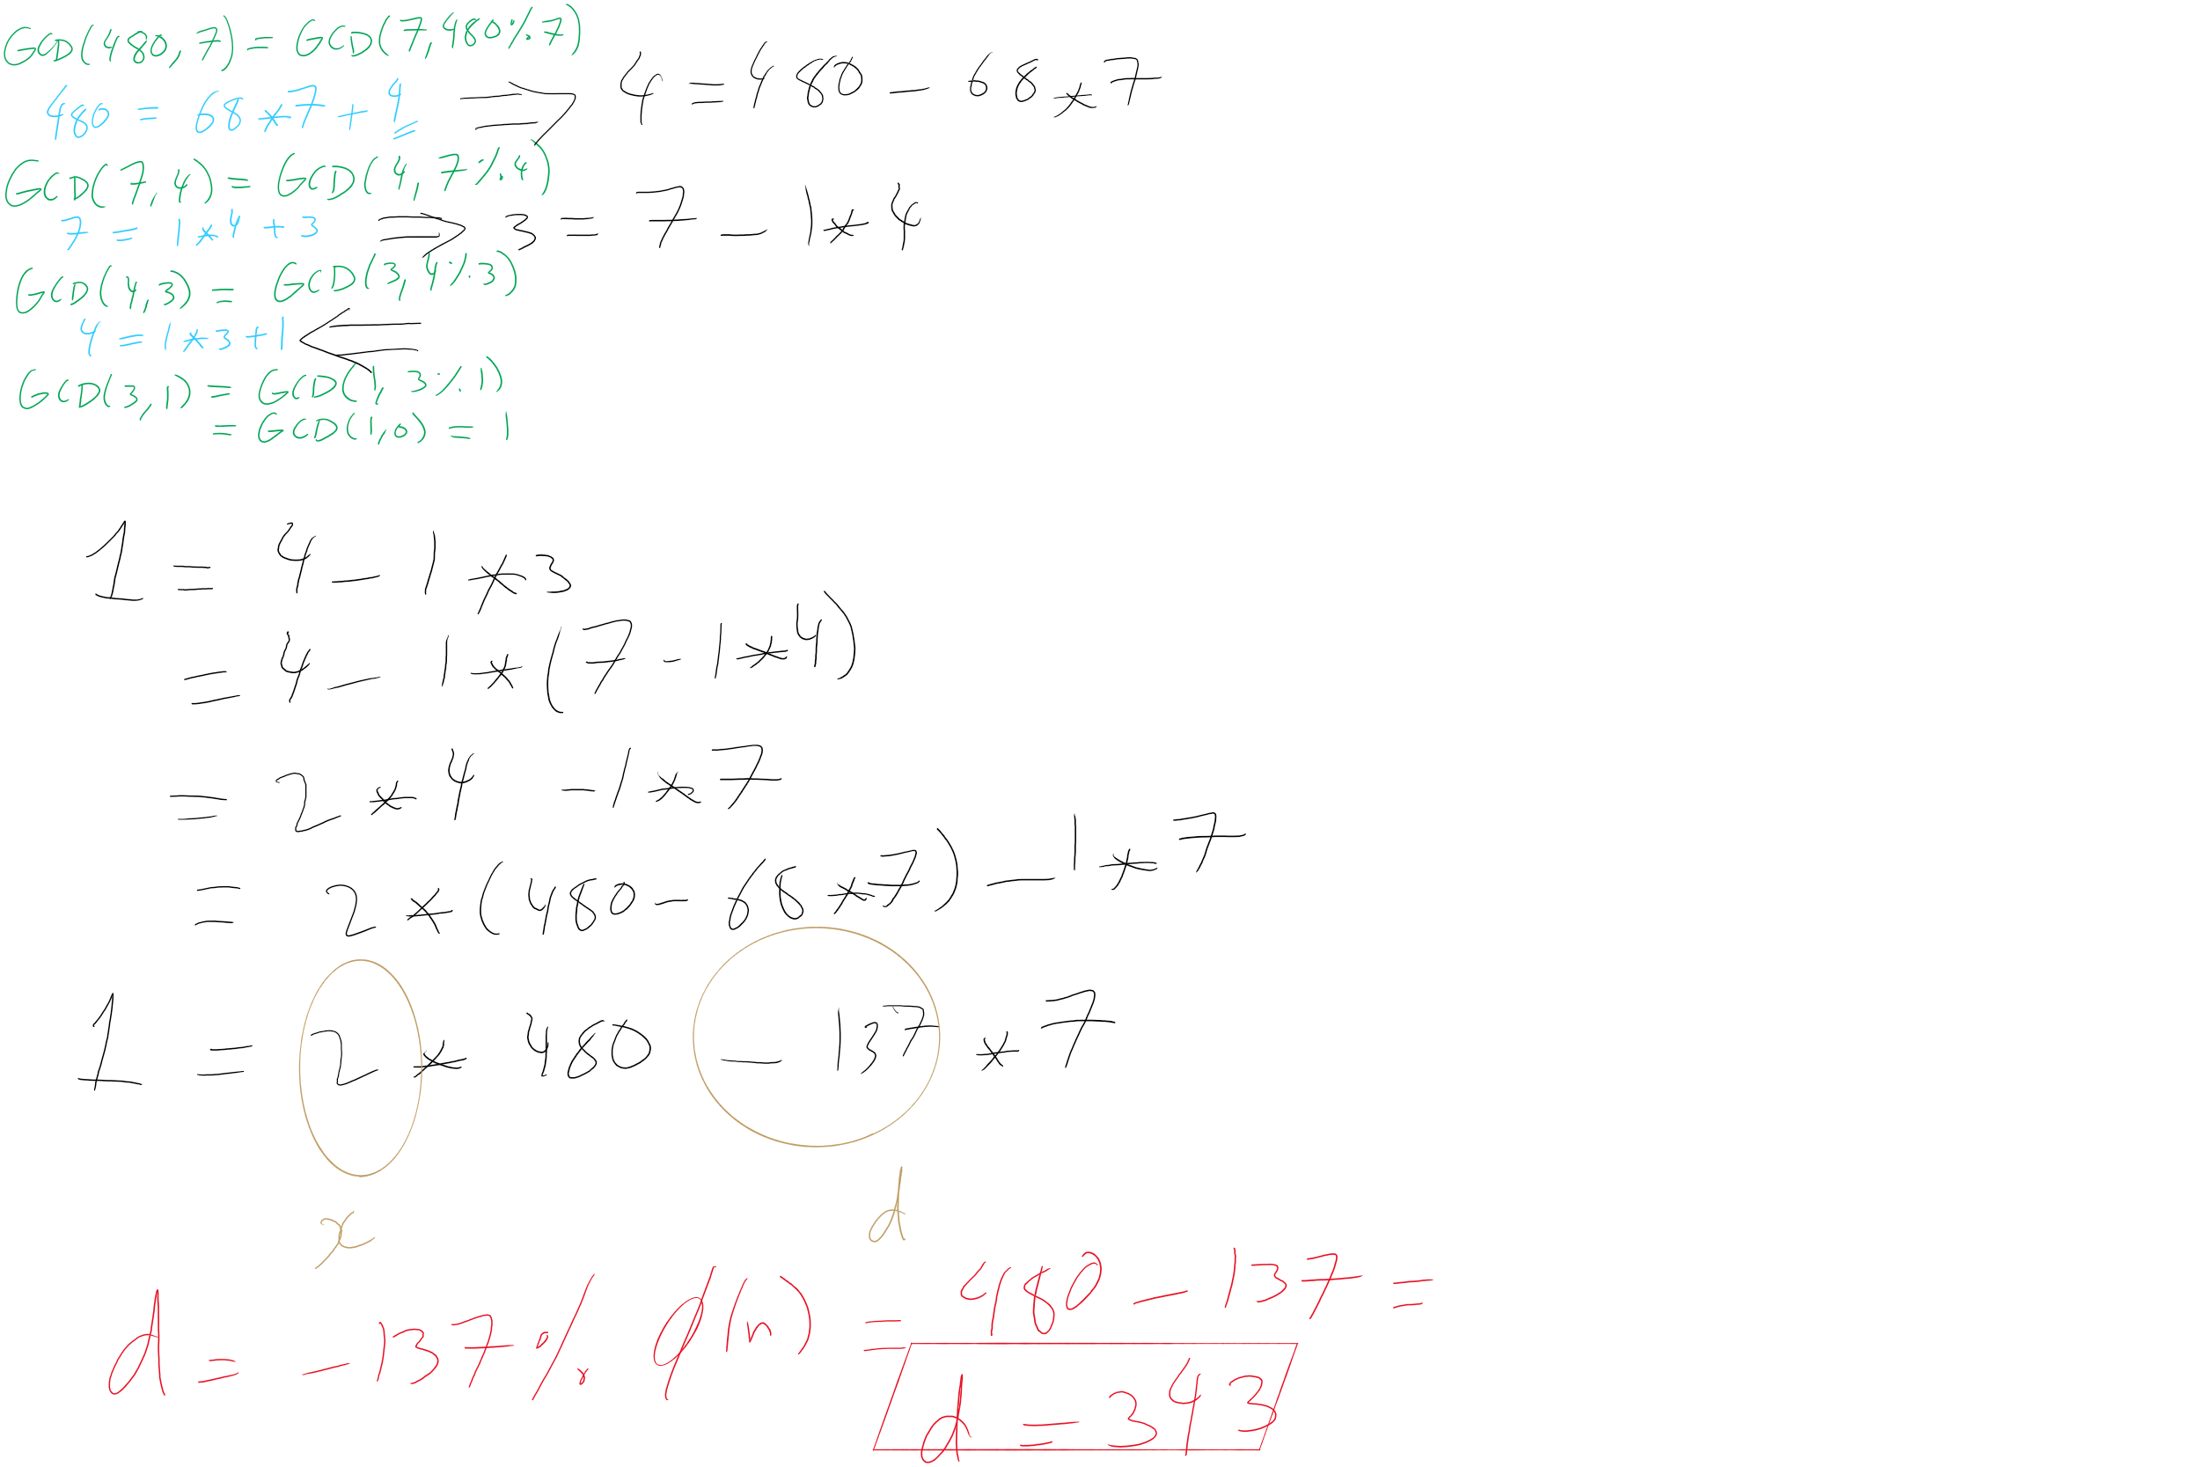
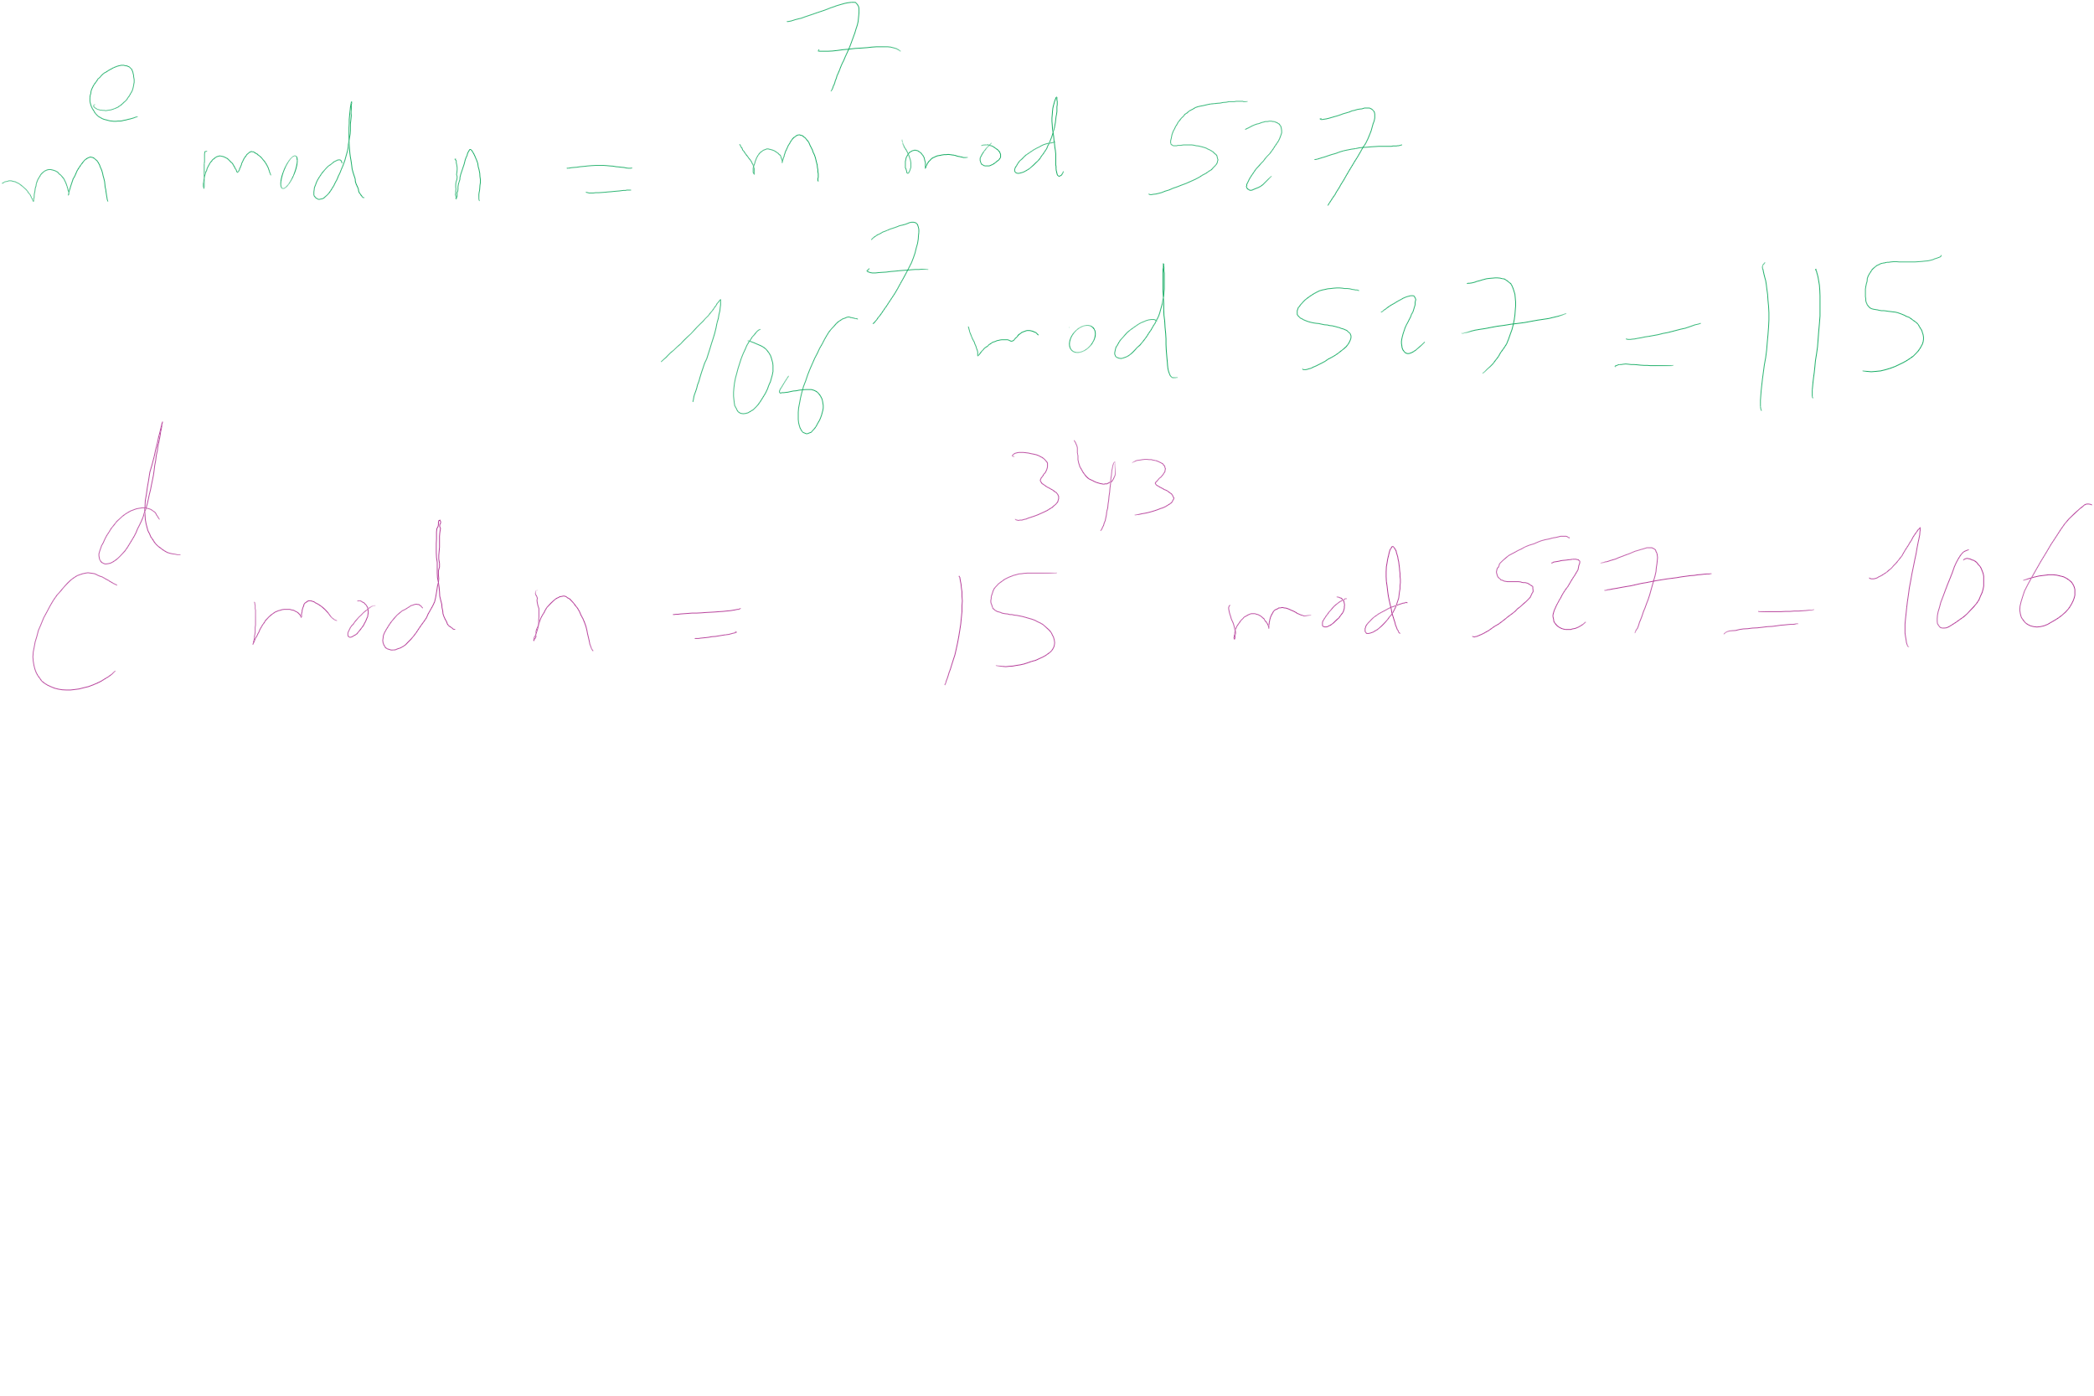
RSA Example 2 (contd.)

Slide 9
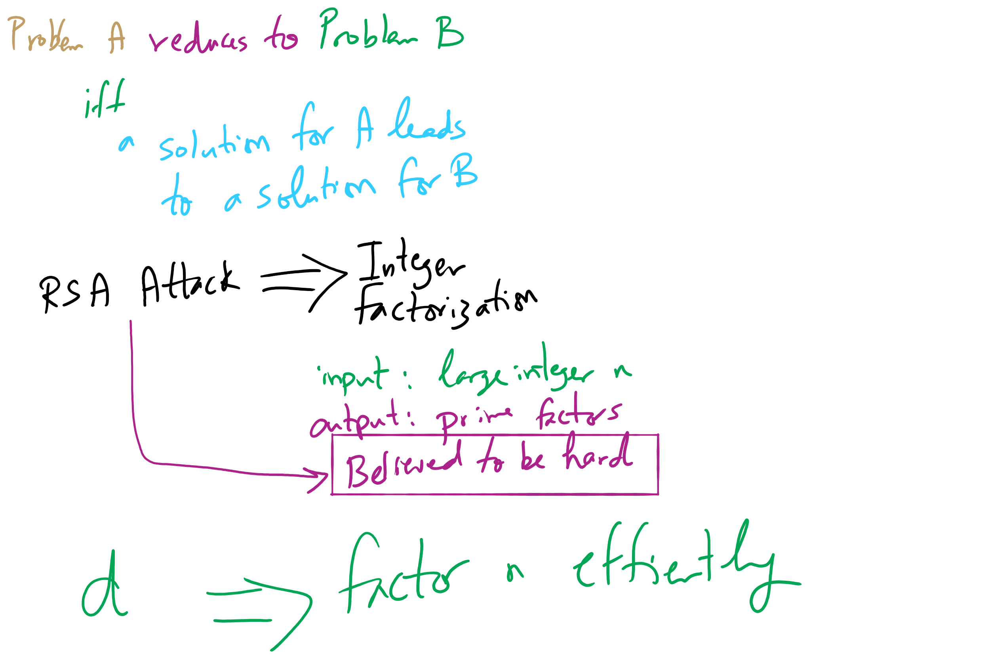
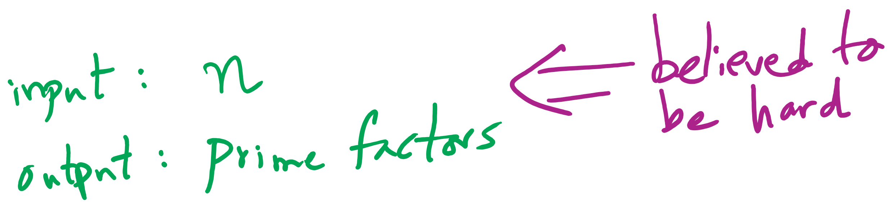
Reduction and RSA Security

Slide 10
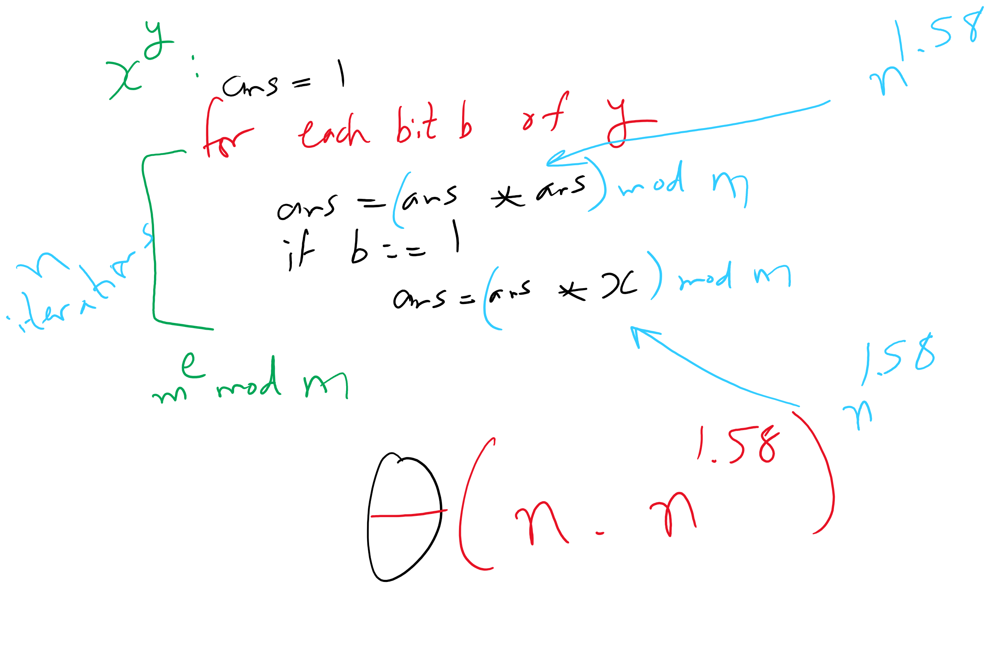
Bottom-up Exponentiation

Slide 11
This Lecture
(Big)Integer Algorithms
RSA encryption
Dynamic Programming

Slide 12
Still slower (generally) than symmetric encryption
If only we could have the speed of symmetric encryption without the key distribution woes!
What if we transmitted symmetric crypto keys with RSA?
RSA Envelopes!
Going back to Alice and Bob
Alice generates a random AES key
Alice encrypts her message using AES with this key
Alice encrypts the key using Bob’s RSA public key
Alice sends the encrypted message and encrypted key to Bob
Bob decrypts the AES key using his RSA private key
Bob decrypts the message using the AES key

Slide 13


RSA Envelope example
KEY_{AES} = rand.nextInt(0, 2²⁵⁶)
KEY_{AES}
KEY_{AES}
SECRET MESSAGE
SECRET MESSAGE
BOB_{PUB}
BOB_{PRIV}
KEY_{AES}
BOB_{PUB}
KEY_{AES}

Slide 14
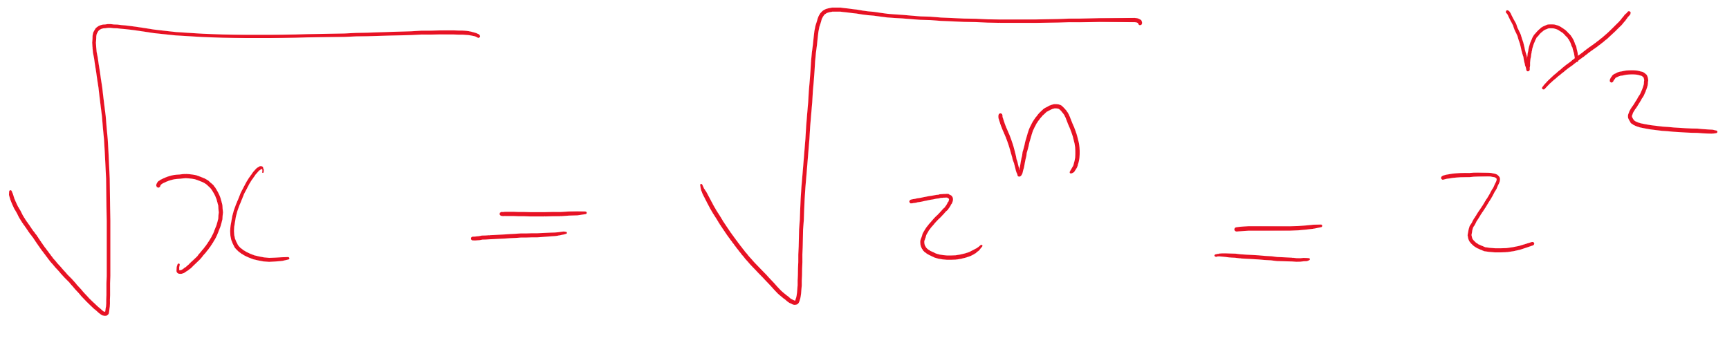
Prime testing option 1: BRUTE FORCE
Try all possible factors of x
1 .. sqrt(x)
aka 1 .. sqrt(2^{size(x)})
For a total of 2^{(size(x)/2)} factor checks
A factor check should take about the same amount of time as multiplication
size(x)²
So our runtime is Θ(2^{(size(x)/2)} * size(x)²)

Slide 15
Option 2: A probabilistic approach
Need a method test : Z×Z → {T, F}
If test(x, a) = F, x is composite based on the witness a
If test(x, a) = T, x is probably prime based on the witness a
To test a number x for primality:
Randomly choose a witness a
if test(x, a) = F, x is composite
if test(x, a) = T, loop
Possible implementations of test(x, a):
Miller-Rabin, Fermat’s, Solovay–Strassen
often probability ≈ 1/2
k repetitions leads to probability that x is composite ≈ 1/2^{k}

Slide 16
Another fun use of RSA...
Notice that encrypting and decrypting are inverses
m^{ed} = m^{de} (mod n)
We can “decrypt” the message first with a private key
Then recover the message by “encrypting” with a public key
Note that anyone can recover the message
However, they know the message must have come from the owner of the private key
Using RSA this way creates a digital signature

Slide 17
Do RSA signatures need to be slow?
We encrypted symmetric crypto keys before to speed things up…
We'll need another crypto primitive to help out here
Cryptographically secure hash functions

Slide 18
Hashing for security (similarities)
Cryptographically secure hash functions share properties with the hash functions we've already talked about:
Map from some input domain to a limited output range
Though output ranges are much larger here
For modern algorithms 224-512 bit output sizes
Time required to compute the hash is proportional to the size of the item being hashed
Though, practically, cryptographic hash functions are more expensive
Notes:
Discuss use of crypto hashing to implement a hash table

Slide 19
Now just sign a hash of the message!
H_{BOB} = h
MSG. DEF. FROM BOB
H_{ALICE} = h
MSG. DEF. FROM BOB
Same?
MSG. DEF. FROM BOB
MSG. DEF. FROM BOB
BOB_{PRIV}
BOB_{PUB}
H_{BOB}
BOB_{PRIV}
H_{BOB}

Slide 20
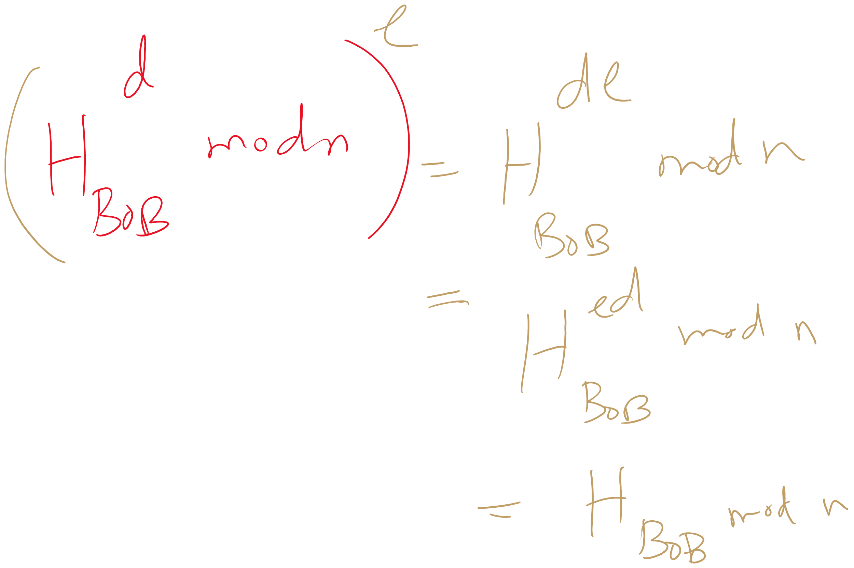
Why does it work?

Slide 21
What about collisions?
If Bob signs a hash of the message “I’ll see you at 7”
It could appear that Bob signed any message whose hash collides with “I’ll see you at 7”...
If h(“I’ll see you at 7”) == h(“I’ll see you after I rob the bank”), Bob could be in alot of trouble
An attack like this helped the Flame malware to spread
This is also the reason Google is aiming to deprecate SHA-1
Notes:
Discuss using modular hashing for digital signatures

Slide 22
Hashing for security (differences)
This is why cryptographically secure hash functions must support additional properties:
It should be infeasible to find two different messages with the same hash value
It should be infeasible to recover a message from its hash
Should require a brute force approach
Small changes to a message should change the hash value so extensively that the new hash value appears uncorrelated with the old hash value

Slide 23
Public key isn’t perfect
What do you do when a private key is compromised?

Slide 24
Final note about crypto
NEVER IMPLEMENT YOUR OWN CRYPTO
Use a trusted and tested library.

Slide 25
Consider the change making problem
What is the minimum number of coins needed to make up a given value k?
If you were working as a cashier, what would your algorithm be to solve this problem?

Slide 26
This is a greedy algorithm
At each step, the algorithm makes the choice that seems to be best at the moment
Have we seen greedy algorithms already this term?
Yes!
Building Huffman trees
Nearest neighbor approach to travelling salesman

Slide 27
… But wait …
Nearest neighbor doesn't solve travelling salesman
Does not produce an optimal result
Does our change making algorithm solve the change making problem?
For US currency…
But what about a currency composed of pennies (1 cent), thrickels (3 cents), and fourters (4 cents)?
What denominations would it pick for k=6?

Slide 28
So what changed about the problem?
For greedy algorithms to produce optimal results, problems must have two properties:
Optimal substructure
Optimal solution to a subproblem leads to an optimal solution to the overall problem
The greedy choice property
Globally optimal solutions can be assembled from locally optimal choices
Why is optimal substructure not enough?
Notes:
Opt. substructure:
If we know the best way to make 3 cents, we can use that to find the best way to make 6 cents
Greedy choice:
When looking to make 6 cents, we know for US currency that the best overall choice will be to use the biggest coin (nickel)
With thrickels/fourters, we can't know until we've looked at all possible breakdowns
Note that this can be done recursively

Slide 29
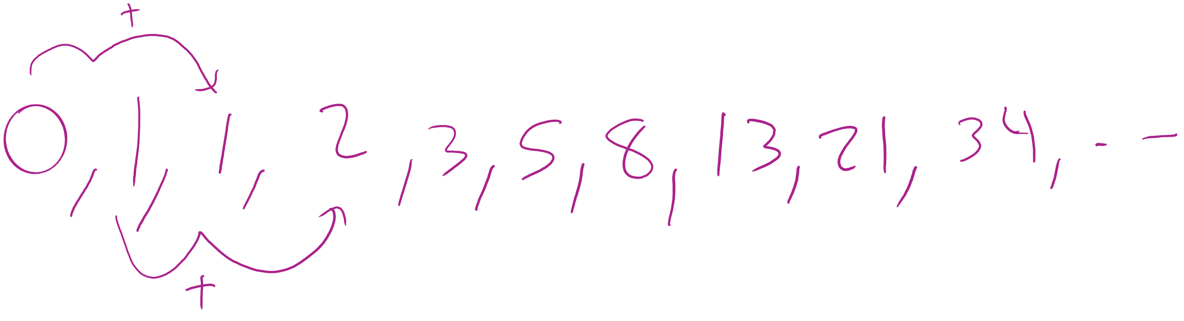
Finding all subproblems solutions can be inefficient
Consider computing the Fibonacci sequence:
int fib(n) { if (n == 0) { return 0 }; else if (n == 1) { return 1 }; else { return fib(n - 1) + fib(n - 2); } }
What does the call tree for n = 5 look like?

Slide 30
fib(5)
fib(5)
fib(4)
fib(3)
fib(4)
fib(3)
fib(3)
fib(3)
fib(2)
fib(2)
fib(2)
fib(1)
fib(2)
fib(1)
fib(2)
fib(2)
fib(1)
fib(1)
fib(1)
fib(1)
fib(0)
fib(0)
fib(1)
fib(0)
fib(1)
fib(0)
fib(1)
fib(1)
fib(0)
fib(0)
Notes:
How many times is fib(1) called?
What about n = 6?

Slide 31
How do we improve?
fib(5)
fib(4)
fib(3)
fib(3)
fib(2)
fib(2)
fib(1)
fib(2)
fib(1)
fib(1)
fib(0)
fib(1)
fib(0)
fib(1)
fib(0)
Notes:
Reuse generated results just like we did with Karatsuba's

Slide 32
Memoization
int[] F = new int[n+1]; F[0] = 0; F[1] = 1; for(int i = 2; i <= n; i++) { F[i] = -1 };
int dp_fib(x) { if (F[x] == -1) { F[x] = dp_fib(x-1) + dp_fib(x-2); } return F[x]; }

Slide 33
Note that we can also do this bottom-up
int bottomup_fib(n) {
if (n == 0)
return 0;
int[] F = new int[n+1];
F[0] = 0;
F[1] = 1;
for(int i = 2; i <= n; i++) {
F[i] = F[i-1] + F[i-2];
}
return F[n];
}
Notes:
THIS IS DYNAMIC PROGRAMMING

Slide 34
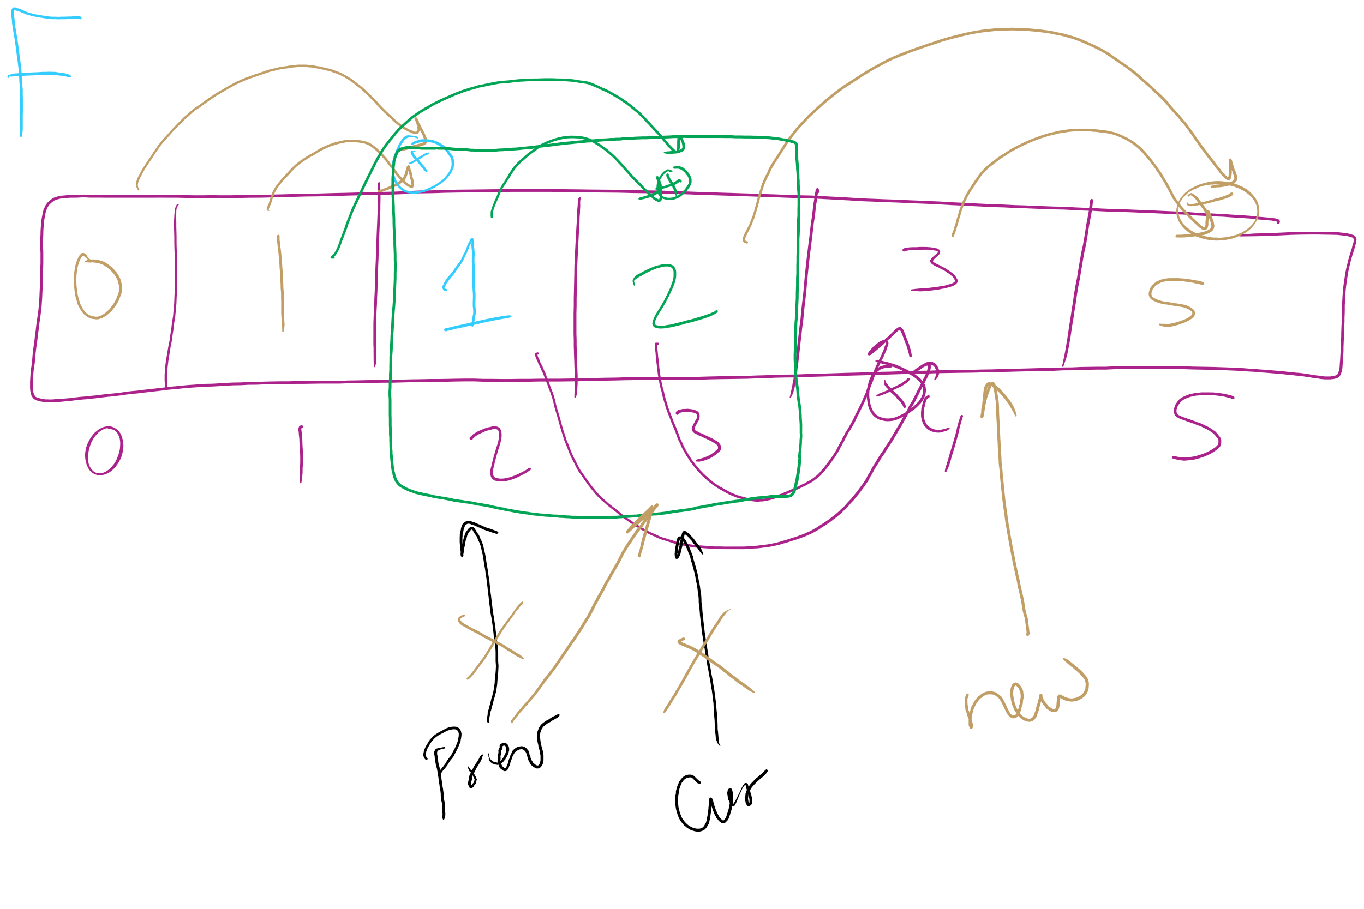
Can we improve this bottom-up approach?
int improve_bottomup_fib(n) {
int prev = 0;
int cur = 1;
int new;
for (int i = 0; i < n; i++) {
new = prev + cur;
prev = cur;
cur = new;
}
return cur;
}

Slide 35
Where can we apply dynamic programming?
To problems with two properties:
Optimal substructure
Optimal solution to a subproblem leads to an optimal solution to the overall problem
Overlapping subproblems
Naively, we would need to recompute the same subproblem multiple times
Notes:
Note that both problems amenable to DP and those amenable to greedy exhibit optimal substructure, the difference is if the greedy choice property exists or if overlapping subproblems

Slide 36
The unbounded knapsack problem
Given a knapsack that can hold a weight limit L, and a set of n types items that each has a weight (w_{i}) and value (v_{i}), what is the maximum value we can fit in the knapsack if we assume we have unbounded copies of each item?
Notes:
Start off asking how to solve problem (greedy or dp?)
Does it exhibit optimal substructure?
Does it exhibit greedy choice property?
Does it exhibit overlapping subproblems?

Slide 37


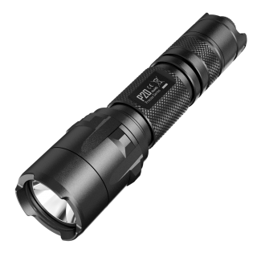
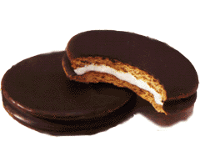

Recursive example
weight:
6
3
4
2
10 lb. capacity
value:
30
14
16
9
How much value in 10 lbs?
4 lbs?
8 lbs?
7 lbs?
6 lbs?
0?
2?
2?
6?
1?
5?
4?
1?
5?
0?
4?
4?
3?
3?
2?

Slide 38
Recursive example
weight:
6
3
4
2
10 lb. capacity
value:
30
14
16
9
How much value in 10 lbs?
4 lbs?
8 lbs?
7 lbs?
6 lbs?
0?
2?
2?
6?
1?
5?
4?
1?
5?
0?
4?
4?
3?
3?
2?

Slide 39
Bottom-up example
weight:
6
3
4
2
value:
30
14
16
9
Size:
0
1
2
3
4
5
6
7
8
9
10
Max val:
0
0
9
14
18
23
30
32
39
44
48
Notes:
Compute values to take max of on board

